Slide 1
Analysis Concepts Initial Perspectives from the CDISC Working Group
Stuart Malcolm, Head of Standards, Efficiency and Automation, Veramed.

Slide 2

Meet the speaker
Stuart has over 30 years’ experience in regulated industries including healthcare, telecommunications, finance and media.
He is co-chair of the PHUSE Emerging Trends and Innovation working group, was co-lead of the Dataset-JSON project and a member of the CDISC 360i Analysis Concept project
Stuart Malcolm
Head of Standards, Efficiency and Automation
Veramed

Slide 3
Disclaimer and Disclosures
The views and opinions expressed in this presentation are those of the authors and do not necessarily reflect the official policy or position of CDISC or Veramed.
The authors have no real or apparent conflicts of interest to report.

Slide 4
Agenda
Problem
Solution
Next Steps
Questions

Slide 5
Problem Statement
Data Standards Are Evolving…

Slide 6
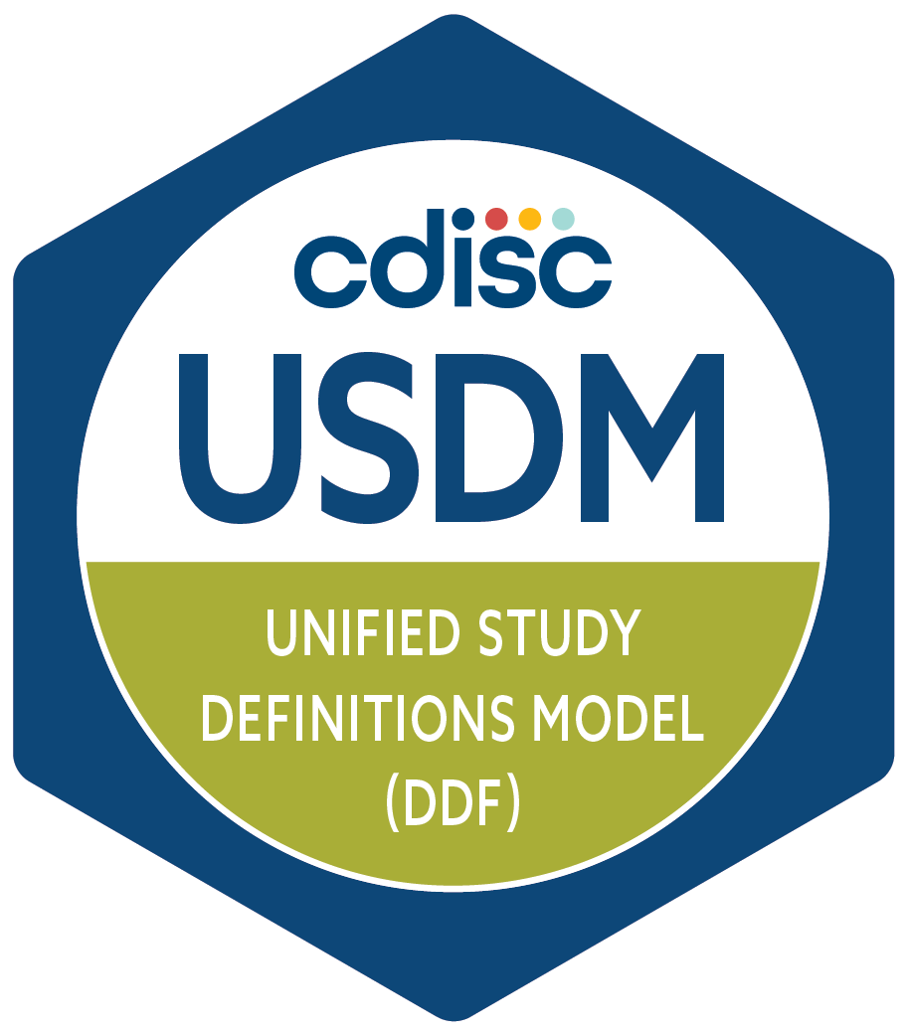
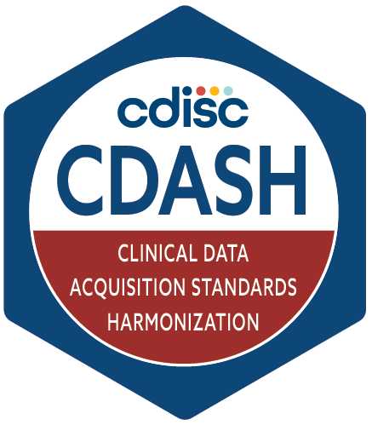
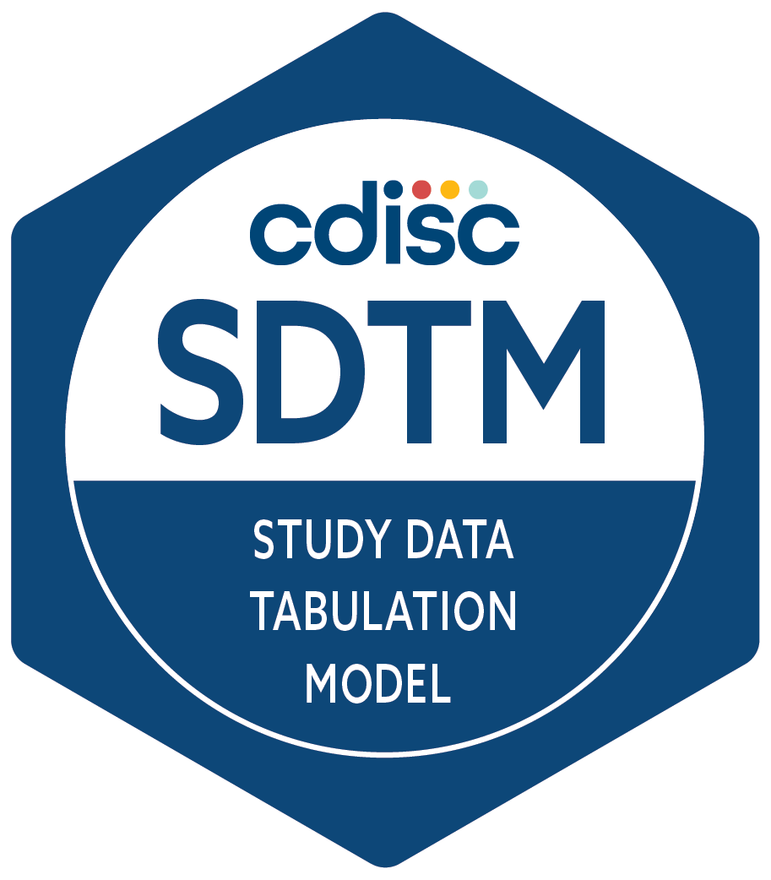
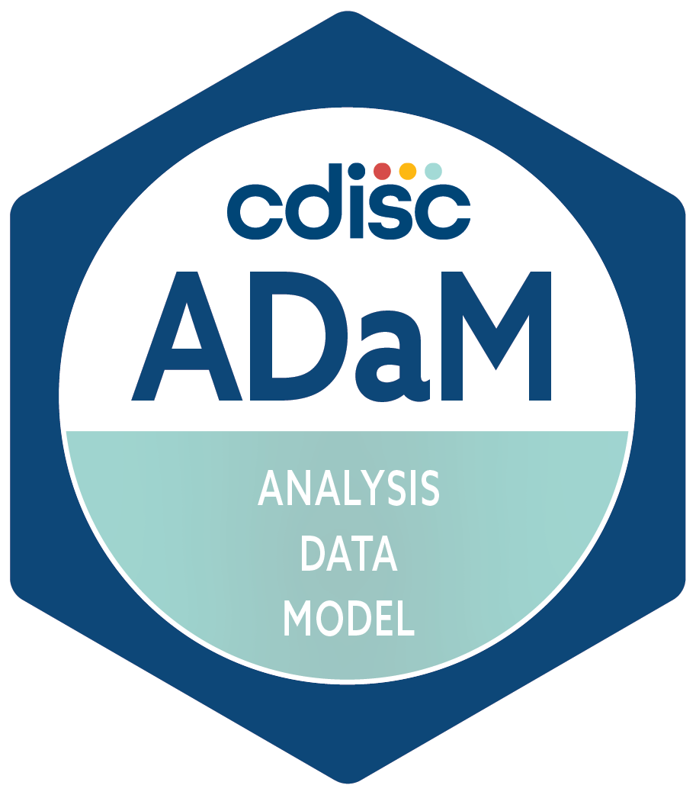
CDISC Standards – November 2025
Protocol
Data collection
Data
tabulation
Analysis data
Analysis results
Analysis outputs
CSR
Notes:
Looking at the trial life cycle, what CDISC standards do we currently have to facilitate automation?
First, the long-established familiar standards:
CDASH for data collection via eCRFs
SDTM provides a framework for representing clinical data once it has been collected. It’s about the presentation of data — not the intent or context behind it.
ADaM – Defines datasets designed to support statistical analyses and traceability back to SDTM.
To this we can add:
USDM to define the study structure

Slide 7
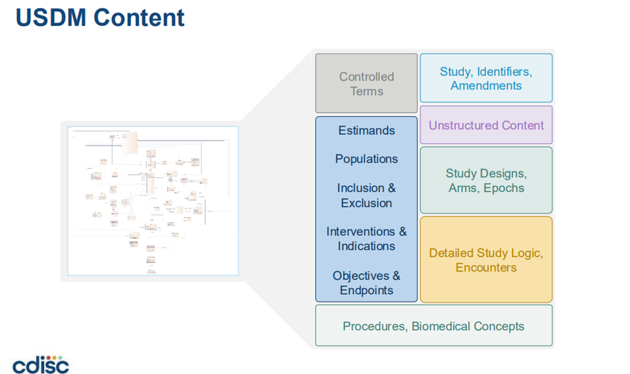
7
Notes:
USDM models lots of metadata defining the study structure, including the Schedule of Activities (SoA) – defines what data is collected when.
Includes elements relevant to the analysis, e.g. estimands, objectives, endpoints.
But when we drill down, some of this is in the form of text.
That is good for compiling a protocol, informing CRF design and many other aspects, but not detailed enough to completely define the analyses.

Slide 8
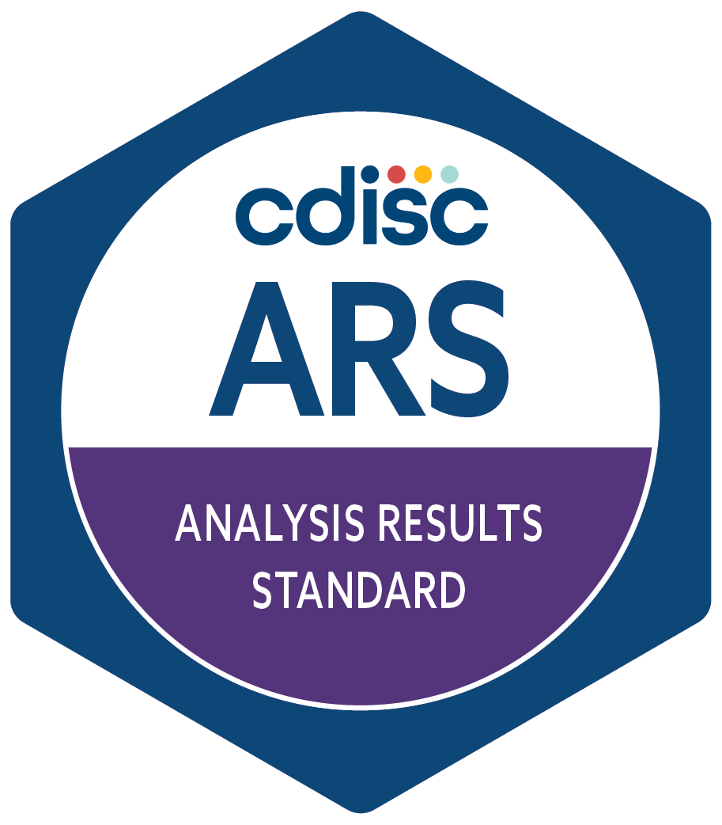
CDISC Standards – November 2025
Protocol
Data collection
Data
tabulation
Analysis data
Analysis results
Analysis outputs
CSR
Notes:
As of April 2024, we can now add the Analysis Results Standard.

Slide 9
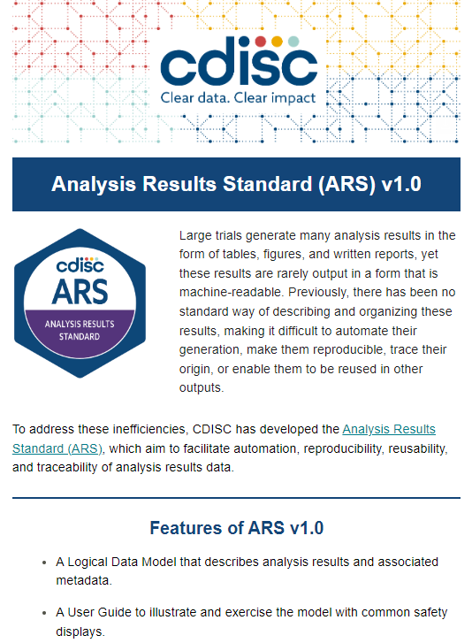
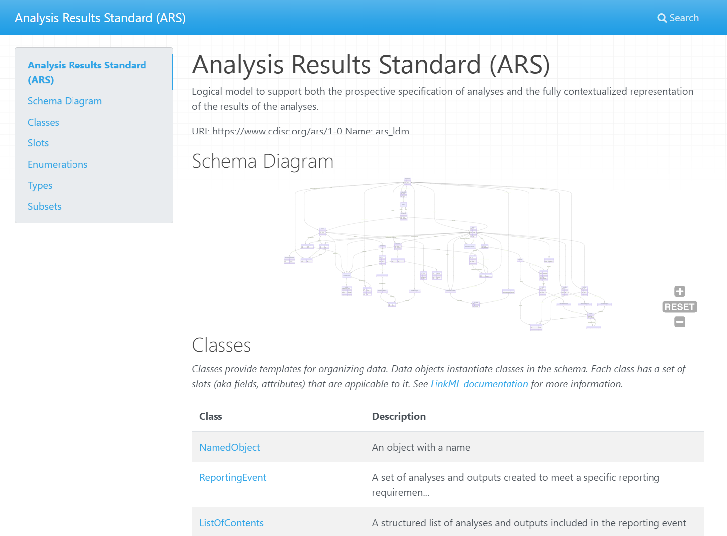
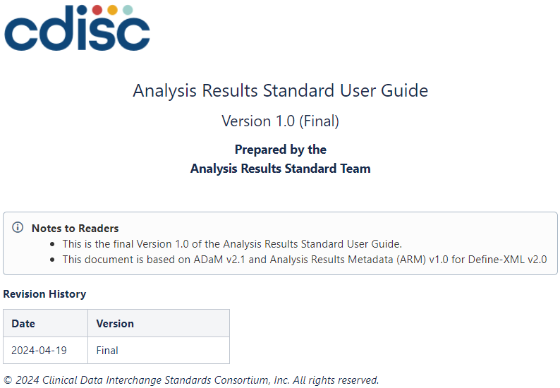
CDISC Analysis Result Standards – Released 2024
https://cdisc-org.github.io/analysis-results-standard/
https://wiki.cdisc.org/display/ARSP/Analysis+Results+Standard+User+Guide+v1.0
Notes:
ARS is a data model for the structure of analyses.
Can be used to specify analyses, facilitating automation.
Provides a structure for analysis results, separate from displays, facilitating validation, re-use and sharing.

Slide 10

CDISC Standards – November 2025
Protocol
Data collection
Data
tabulation
Analysis data
Analysis results
Analysis outputs
CSR
Notes:
Informing the design and collection steps, we also have Biomedical Concepts.

Slide 11
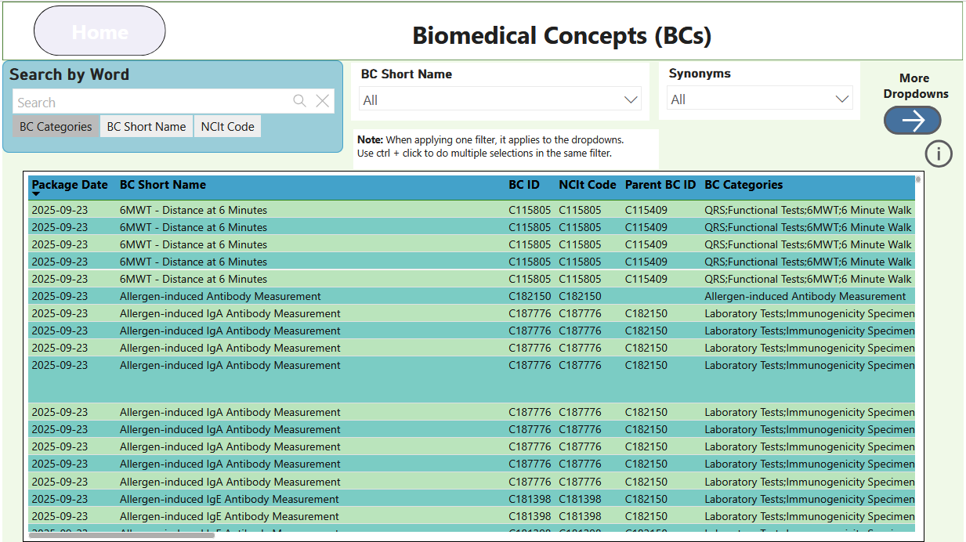
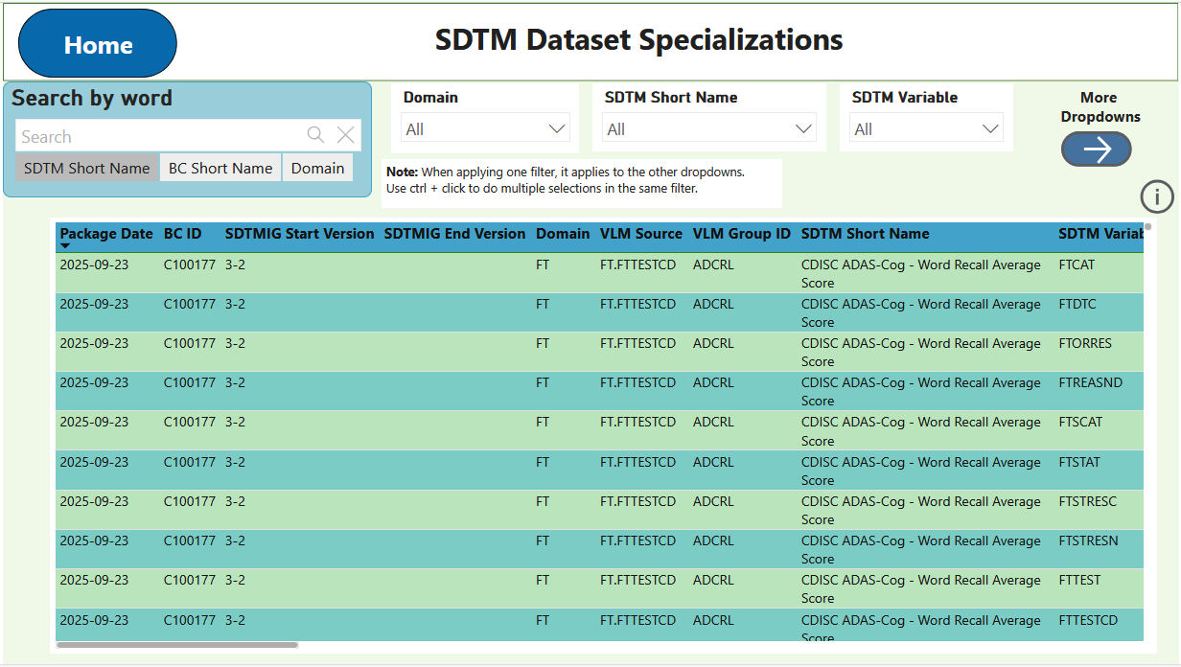
CDISC Biomedical Concepts
Notes:
Biomedical Concepts fill gaps in the current standards by adding semantics, variable relationships, and the detailed metadata.
Two-layered approach:
Conceptual/abstract layer that provides standards-agnostic, unambiguous semantic definition largely based on NCIt concepts.
An implementation layer consisting of SDTM Dataset Specializations provides value level definition that facilitates metadata-driven automation.
This was important for the AC team as we considered how Analysis Concepts might fit into the picture.

Slide 12
Where Analysis Concepts fit
Derivation Concepts
What needs to be derived to support the analysis?
Analysis Concepts
What analysis is needed to answer the question?
Protocol
Data collection
Data
tabulation
Analysis data
Analysis results
Analysis outputs
CSR
Notes:
We still thought there are gaps that prevent full language-agnostic definition of analyses and therefore block full automation.
E.g. How do we model the precise definition of an analysis to answer a particular question?
That is the sort of entity we can call an Analysis Concept.
As we started thinking about how to do this, we soon realized we also need a slightly different kind of concept.
The inputs to an analysis are often derived from the collected data in some way.
To completely understand an analysis we also need to understand those derivations, so those also need be modelled.
Hence the Derivation Concept.

Slide 13
Standards Use-Cases
Use Case 1: Accelerating Study Start-Up
As a study statistician, I want to select from a library of Analysis Concepts so that I can quickly draft the digital Statistical Analysis Plan (SAP) and identify needed datasets and variables.
Use Case 2: Enabling Metadata-Driven Automation
As a clinical data standards expert, I want to build a structured repository of Analysis Concepts so that downstream automation tools (e.g., TFL code generators, validation scripts) can use them as inputs.
Use Case 3: Automating Standard Analyses Across Studies
As a statistical programmer, I want to use pre-defined Analysis Concepts so that I can automate the generation of standard TFLs across studies without recreating logic each time.
Notes:
We used user stories to scope what Analysis Concepts should be able to do. Example use cases:
Build a digital SAP.
Build a repository of reuseable ACs.
Automate analysis programming.

Slide 14
The AC/DC Framework
Work in progress

Slide 15
Today's specification of analysis
Written in plain text
Not machine readable
Some details are left out
Often (at best) retrievable from the analysis executable program/define.xml
Reason why regulators require programs to be submitted
Specifications are not always software agnostic
SAS versus R syntax
Different set of options
Primary analysis from CDISC pilot study
The primary analysis of the ADAS-Cog (11) at Week 24 will use the efficacy population with LOCF imputation for any missing values at Week 24.
An ANCOVA model will be used with the baseline score, site, and treatment included as independent variables. Treatment will be included as a continuous variable, and results for a test of dose response will be produced. Interaction terms will not be investigated.
If the test for dose response is statistically significant, pairwise comparisons among the 3 groups will be performed and evaluated at a significance level of 0.05.
#ClearDataClearImpact

Slide 16
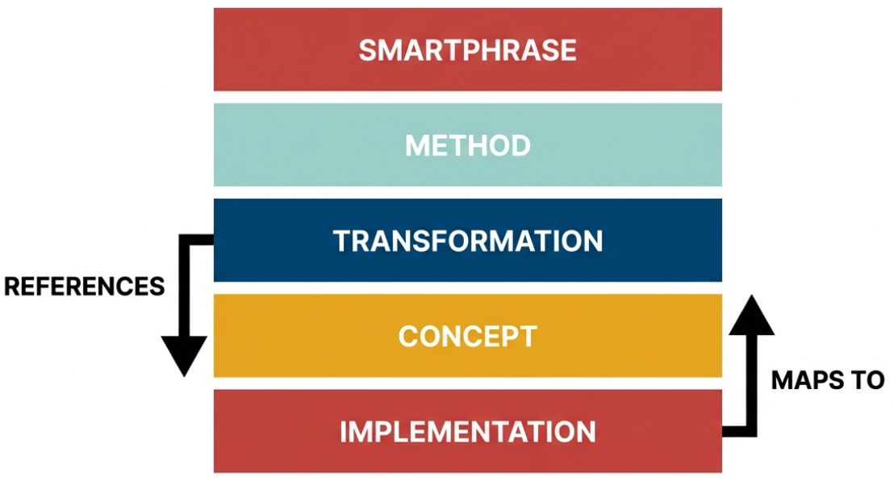
Proposed 5-Layer Architecture

Slide 17
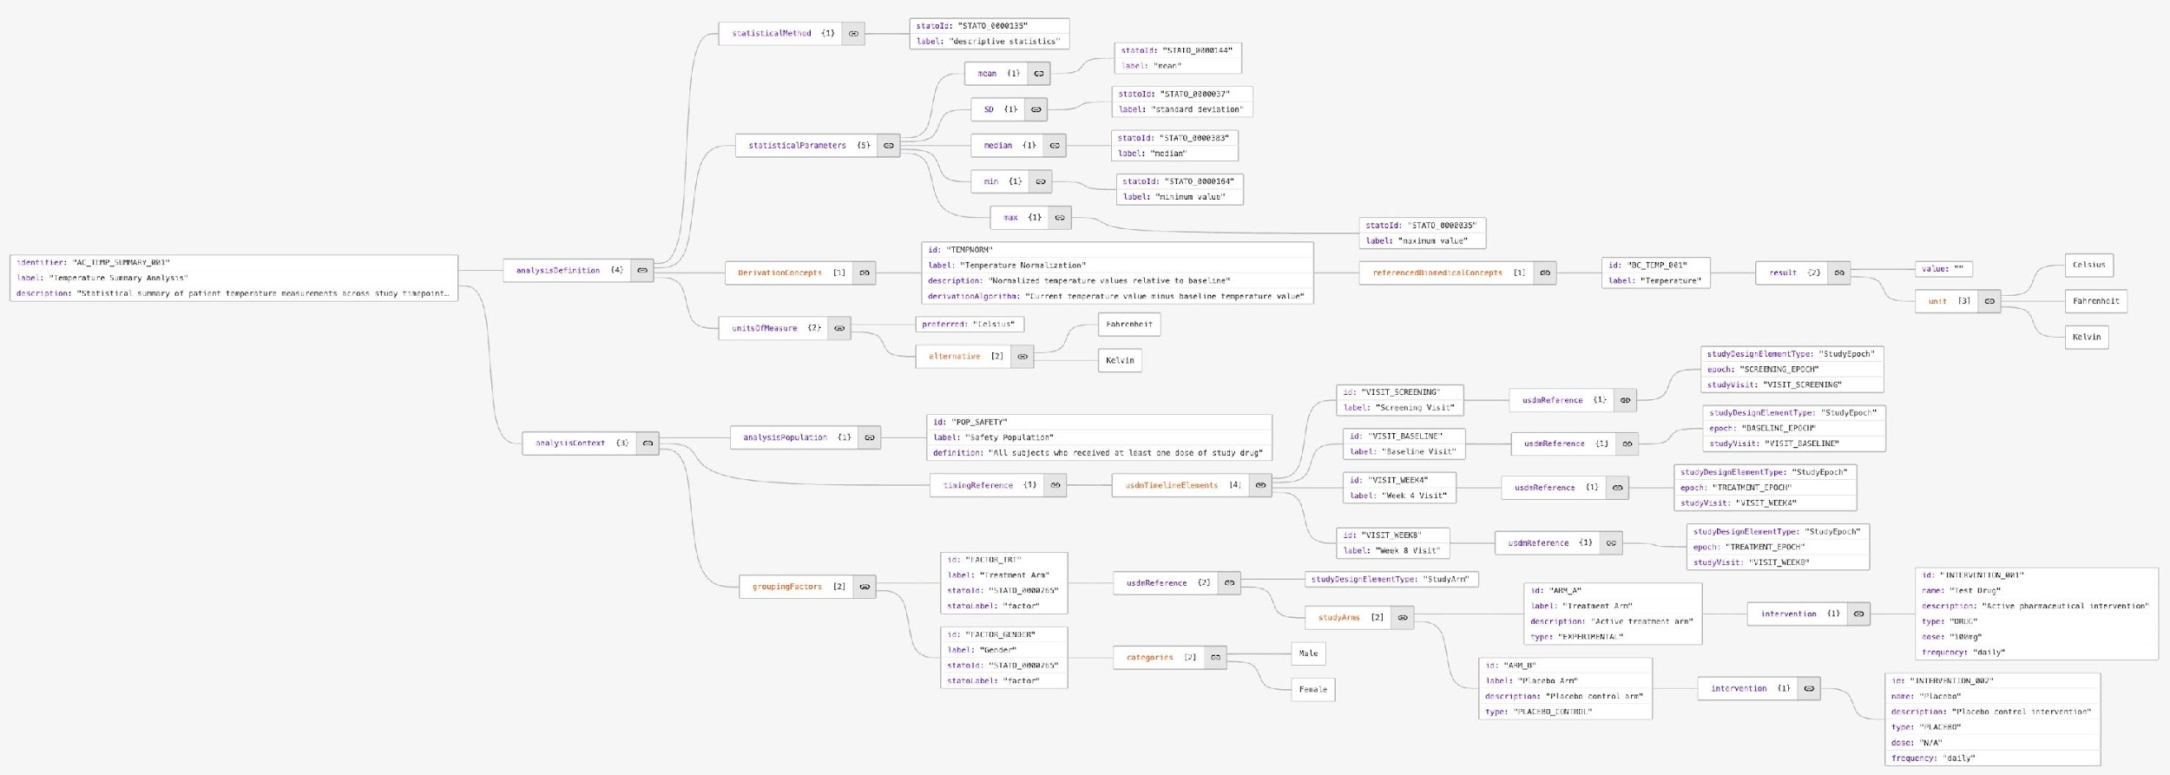
Layer 1: Human-readable analysis descriptions
endpoint
BC
timing
statistical method
Change in ADAS-Cog at Week 24 based on an ANCOVA model, which includes the
baseline score, site, and treatment as continuous variable
covariates
#ClearDataClearImpact

Slide 18
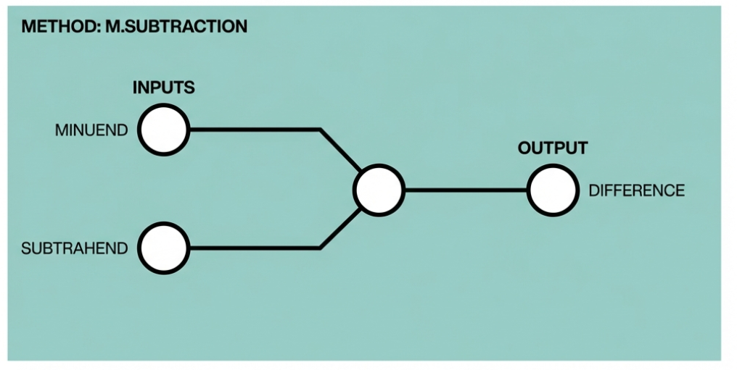
Layer 2: Abstract statistical logic
Pure operations. Standards-Agnostic. Knows nothing of Concepts

Slide 19
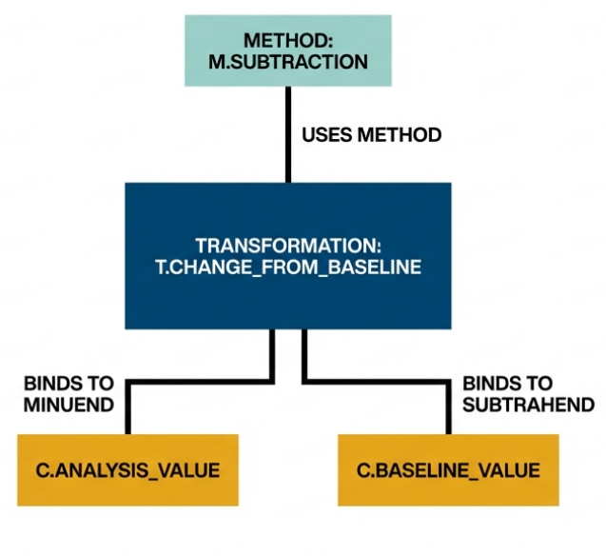
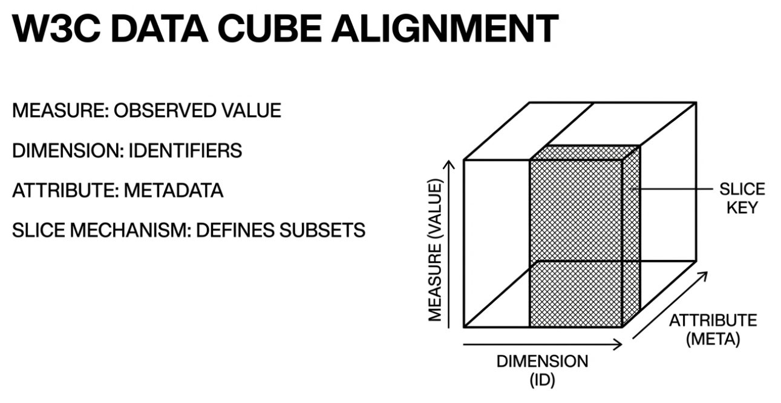
Layer 3: Describing the analysis data structure

Slide 20
Layer 4: Standards-Independent semantic definitions
 | Analysis Concept (AC) | Derivation Concept (DC)
Purpose | Examines existing data or information to draw conclusions, identify patterns, or test hypotheses | Generates new derived values from raw or derived data
Direction | Typically works with completed measurements or observations to extract meaning | Transforms or processes data to create new representations
Process | Involves applying statistical methods, critical thinking, and interpretative frameworks to understand data | Uses mathematical operations, formulas, or algorithms to calculate new quantities
Outcome | Produces insights, conclusions, or evaluations based on the data - aggregated data (not subject-level) | Creates derived data (subject level) that serve as inputs for subsequent analysis or derivations
Example 1 | The p-value (from Type III Sums of Squares for treatment dose), based on linear model analysis of CHG for dose response; using randomized dose and site group in model. | CHG: Change from Baseline to Week 24 in ADAS Cog (11). Use LOCF is missing value at week 24.
Example 2 | Mean value of CHG by visit | CHG: Change from BASELINE in ADAS Cog (11) by visit BASELINE = 'Y' if ADAS Cog (11) at visit 2

Slide 21
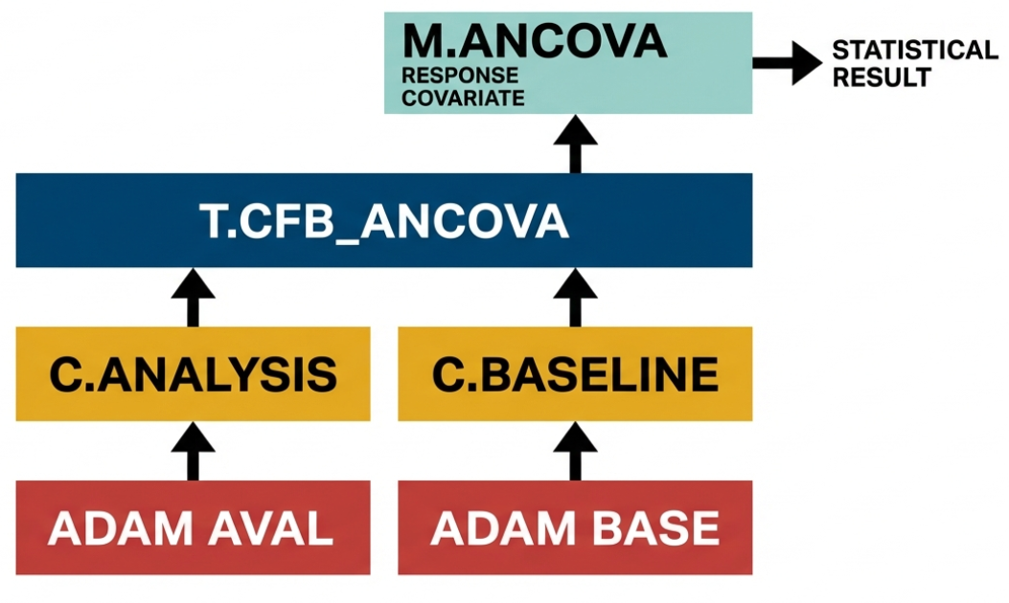
Example (ANCOVA)

Slide 22
Use cases
as a statistician, I can define the nuances of my analyses so that a human or AI programmer can accurately implement the analyses
as a statistician, I can search for and reuse Analysis Methods
as a statistician, I can connect methods that have different implementations, different implementation contexts
as an academic, I can publish structured analysis design to journals
as a programmer, I can understand the impact analysis of changes to SAP
as a regulatory reviewer, I can understand unambiguously what analysis was done
as a statistician, I can trace from the analysis conducted to the data point which contributed to the analysis

Slide 23
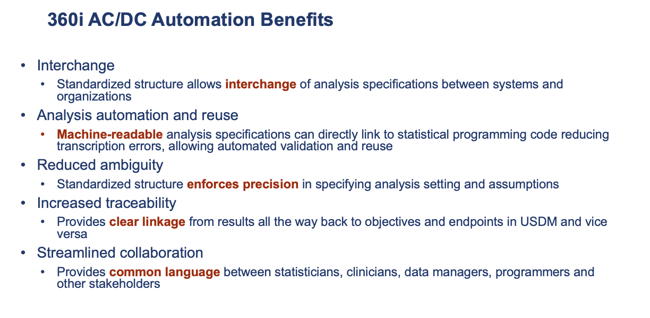

Slide 24
Next Steps

Slide 25
Technical and Model Development
Data Model
Refinement
Defining Boundaries
Leverage Ontologies
Community & Industry Engagement
Relatable to
CDISC Standards
Industry Feedback
Consumable Demonstrations
Strategic Opportunities & Challenges
Early
Onboarding
Change
Management
Tooling
Notes:
The next steps for the Analysis Concepts (AC) and Derivation Concepts (DC) framework involve refining the technical model and ensuring its practical application within the CDISC community. The sources outline the following specific actions:
Technical and Model Development
Data Model Refinement: The working group plans to continue developing the formal Data Model and providing concrete examples of its implementation.
Defining Boundaries: A key task is to define the exact boundaries and relationships between this framework and other CDISC standards, specifically the Unified Study Definitions Model (USDM), the Analysis Results Standard (ARS), and Biomedical Concepts (BCs).
Leveraging Ontologies: The group will determine how to effectively leverage existing statistical ontologies, such as STATO, to ensure standardized semantic definitions.
Community and Industry Engagement
Relatability to CDISC: Efforts will be made to make the framework more relatable to the broader CDISC community. A primary goal in this area is the potential creation of a digital or electronic Statistical Analysis Plan (eSAP).
Industry Feedback: It is recognized that industry feedback is essential, as the framework cannot predefine every possible clinical scenario.
Consumable Demonstrations: There is a stated need to demonstrate the framework's utility in a "consumable manner" to encourage adoption and understanding among stakeholders.
Strategic Opportunities and Challenges
Early Onboarding: The framework seeks to get regulatory authorities and industry partners involved early in the process.
Change Management: Addressing potential pushback and managing the shift toward requiring more precise Statistical Analysis Plans earlier in the study lifecycle is a noted challenge.
Tooling: Developing supporting tools is identified as a significant opportunity to advance automation and traceability.

Slide 26
Questions

Slide 27
Thank You!

